Slide 1

FUN WITH WSL!
Mike Nelson
VMware Explore VMTN 2022

Slide 2






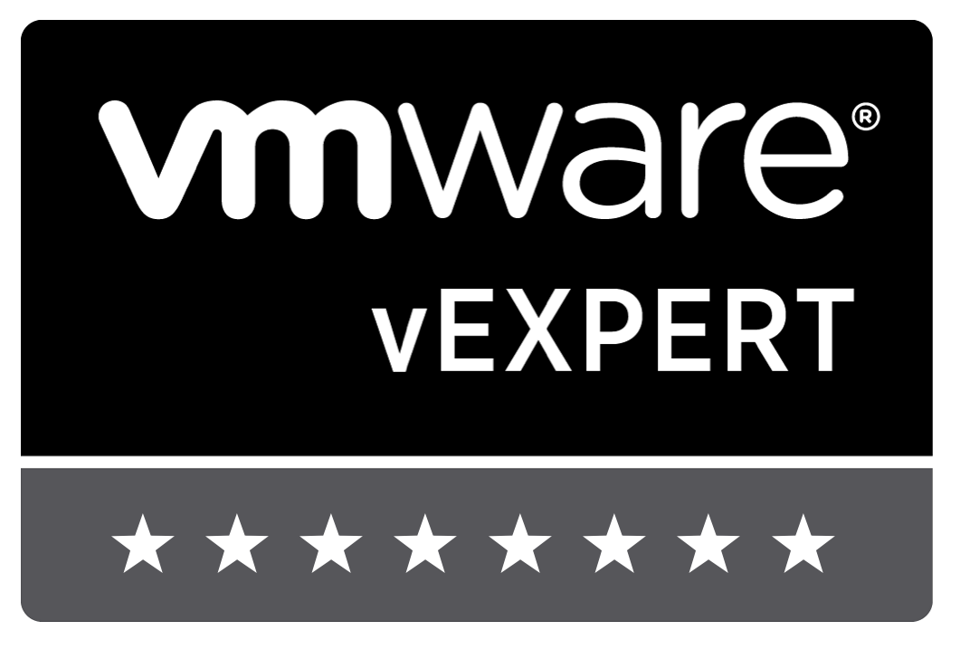
mikenelsonio
Mike
nelmedia
mikenelson-io
35+ years in tech
Principal Technologist
Experience from Helpdesk to Architect
Scripter, not a coder
Passion for community, teaching, learning
Beer, BBQ, & Gadgets

Slide 3

/MyPresentations/2022-August_vmware explore vmtn

Slide 4

Windows Subsystem for Linux - WSL
2 variants – stable & preview
2 versions – v1 & v2
Use v1 for Linux to Windows file intensive operations/applications
V2 required for advanced compatibility, optimizations, & features
Runs on Windows Client (W10 v2004+, W11) & Server (KB 5014678)
Open source

Slide 5

“Linux is a cancer that attaches itself in an intellectual property sense to everything it touches. That’s the way that the license works.”
– Steve Ballmer (2001)
“Free Software licenses are the devil’s work.”
– Microsoft PR Statement (2001)
We make peace with our enemies, not our friends.
- Tyrion Lannister

Slide 6

Why WSL?

Slide 7



Versions
WSL v1
WSL v2
Lightweight Utility VM
Linux Distro
Windows Usermode
Linux Usermode
WSL
Translation layer
Windows NT Kernel
Linux Kernel
Windows NT Kernel
Virtual Machine Platform

Slide 8
Components
WSL
+
Distributions (Distros)
Virtual Machine Platform (HVC)
wsl.exe
Kernel
Shell
File system
Graphics
Sound
Network
Ubuntu
Debian
Kali
Oracle
Suse
OpenSuse
Fedora Flux
Alpine
Alma
Pengwin
Raft
Rocky 8
AOSC
“Un-Official”
Custom

Slide 9
Installation
WSL
Distributions (Distros)
wsl --install (W10 v2004, W11, Server 2022)
will set v2 as default & install default Ubuntu distro
Control Panel
Dism
dism.exe /online /enable-feature /featurename:Microsoft-Windows-Subsystem-Linux /all /norestart
PowerShell
Enable-WindowsOptionalFeature -Online -FeatureName Microsoft-Windows-Subsystem-Linux
Download as bundle (ex. Server 2019, dark sites)
Github
wsl --install --d <distroname>
W10 v2004, W11, Server 2022
Download as bundle & install as AppX Package or zip file
Required for Server 2019 & older, optional for Server 2022
Unofficial distros may have other means

Slide 10
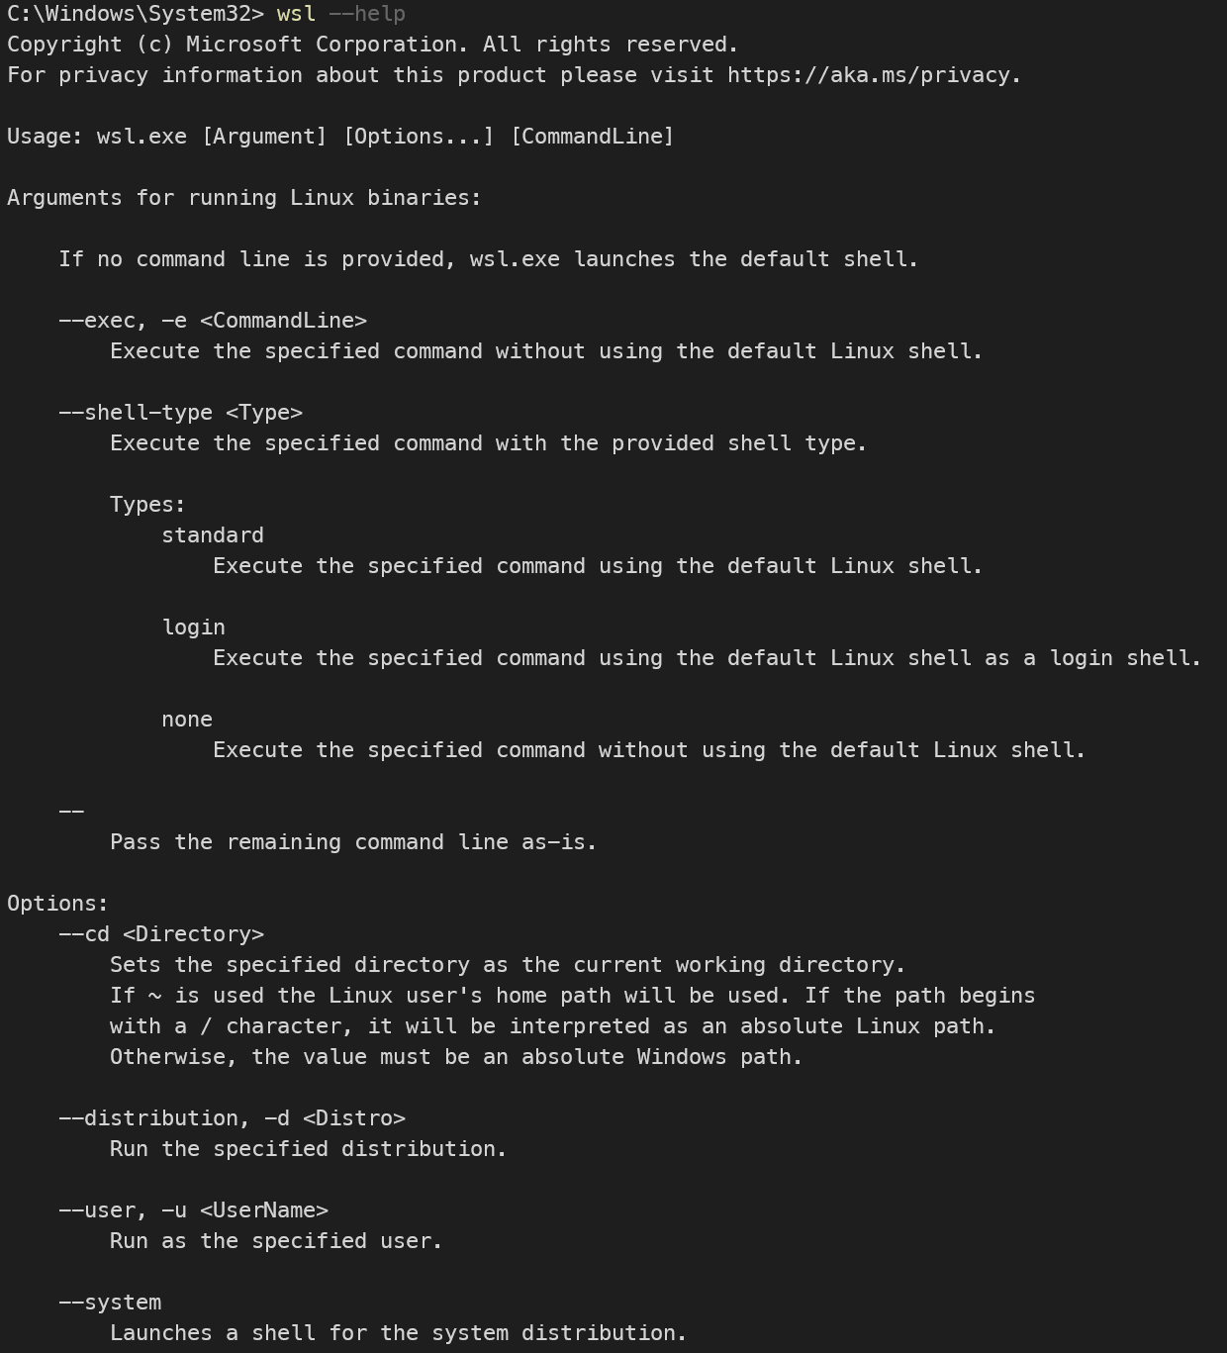
wsl.exe
Command line interpreter for WSL
Install, update, & check status of wsl
Install distro & set default distro
List installed & available distros
Export & import wsl images
Register & unregister distro
Mount a disk or device
Execute commands within a shell
Change shells
Set wsl version per distro & default
Run-as & change user

Slide 11
Interoperability
Files & Drives
Apps & Processes
Bi-directional files & folders
Bi-directional working file copies are not recommended
Case sensitivity (use fsutil.exe in Windows to set)
Symlinks support for Windows
Invalid Windows filenames – UNC paths not supported
Best effort permissions from Linux to Windows
Linux - Drive mounts are in /mnt
Linux - USB drive mounts supported
wslpath utility to view/change pathing
Run Windows tools from Linux
~$ notepad.exe
*Run Linux tools on Windows (wsl.exe)
C:\>wsl.exe ls-la
Combine OS commands
C:\>dir | wsl grep hello
~$ ipconfig.exe | grep IPv4 | cut -d: -f2
Environment variables shared with WSLENV
Some apps know WSL (ex. Docker Desktop)
To *disable interoperability: ~$ echo 0 > /proc/sys/fs/binfmt_misc/WSLInterop
*Does not persist across sessions

Slide 12
Advanced Configuration
/etc/wsl.conf
%UserProfile%/.wslconfig
Distro wsl v1 & v2 config
4 sections – [automount], [user], [interop], [network]
1 section in preview only – [boot]
Global wsl v2 config
1 section – [wsl2]

Slide 13
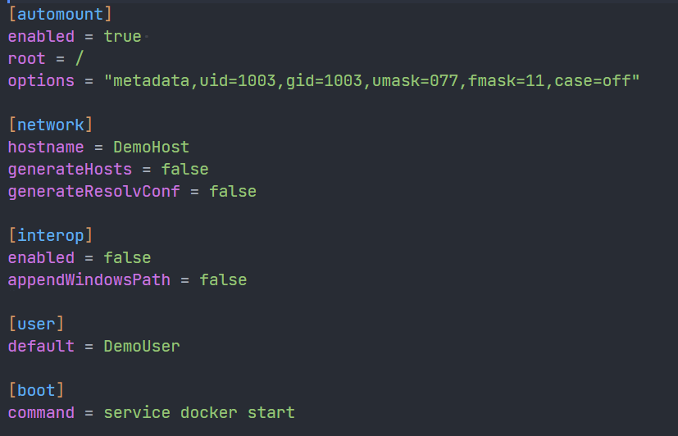
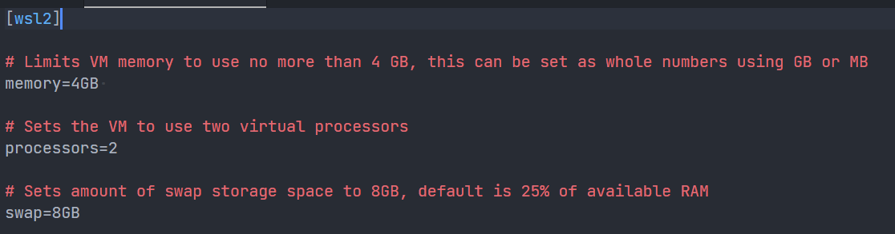
Advanced Configuration
/etc/wsl.conf
%UserProfile%/.wslconfig

Slide 14
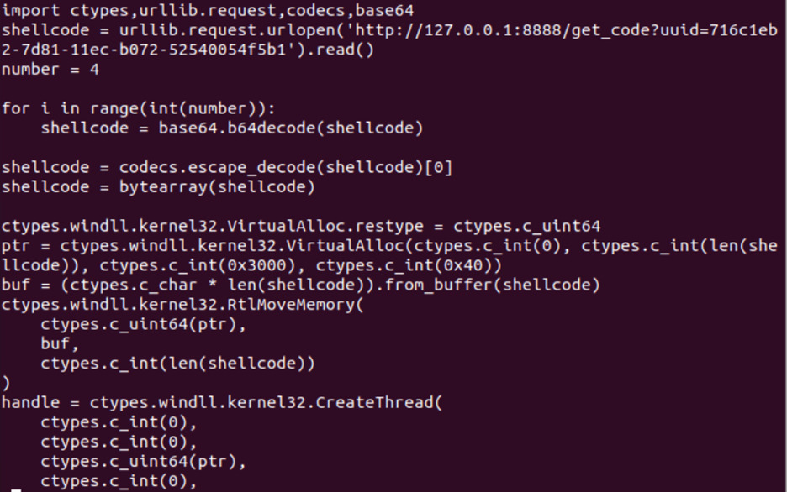

WSL Vulnerabilities
Black Lotus Labs discovered first in the wild exploit in 2021
Agents, remote shell, Telegram-bot, password dumper, etc.
SANS whitepaper - https://www.sans.org/white-papers/39330/
Shells are always vulnerable exploit, penetration, and exfiltration points in any OS.

Slide 15
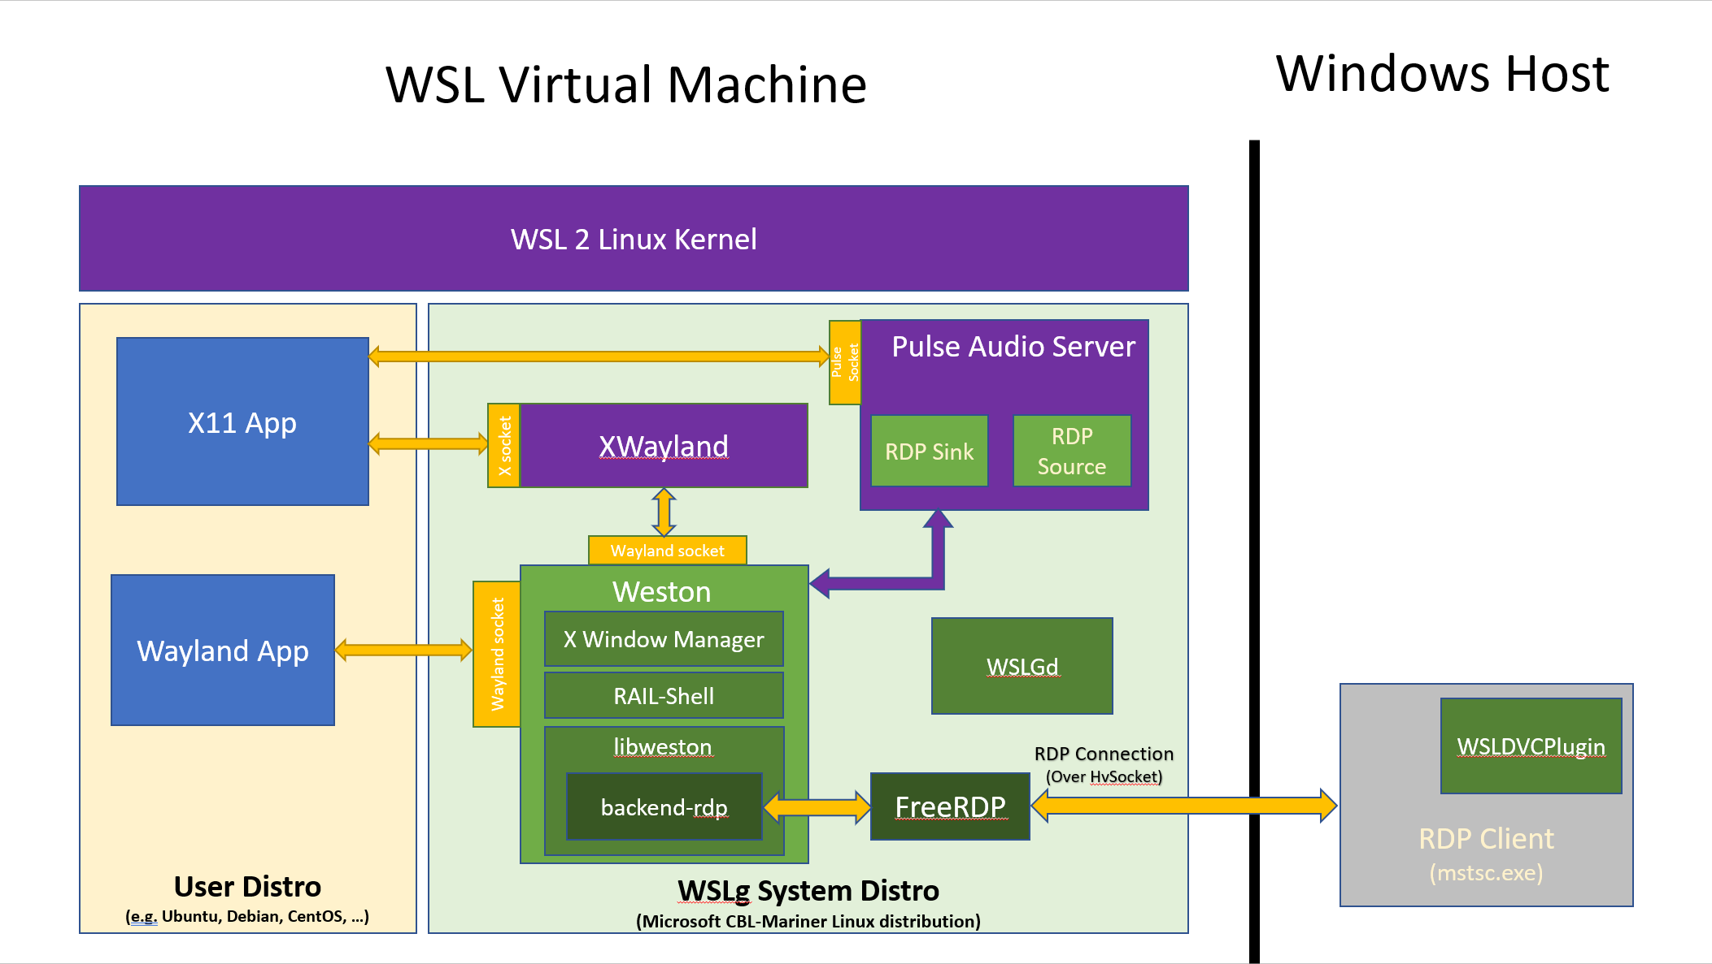
Graphics - wslg
Brings X-Windows apps to WSL
Requires W11 build 22000.* or W11 Insider Preview builds 21362+
Intel, Nvidia, AMD vGPUs
Nvidia CUDA driver available
User & System distros
https://github.com/microsoft/wslg

Slide 16
Demo WSL

Slide 17
WSL Tidbits
VPN to WSL instance (based off an Alpine distro) - https://github.com/sakai135/wsl-vpnkit
Create multiple instances of Ubuntu - https://github.com/mikenelson-io/WslGen
WSL PowerShell module - https://github.com/SvenGroot/WslManagementPS
WSL on Mac via Parallels - https://patrickwu.space/2020/02/14/wsl-on-mac/

Slide 18
Thank you!
@mikenelsonio
GitHub - mikenelson-io
LinkedIn - nelmedia

